Slide 1
Time Series Analysis
Basics of Time Series Analysis
Nicoleta Serban, Ph.D.
Associate Professor
Stewart School of Industrial and Systems Engineering
Decomposition: Seasonality Estimation

Slide 2
About this lesson

Slide 3
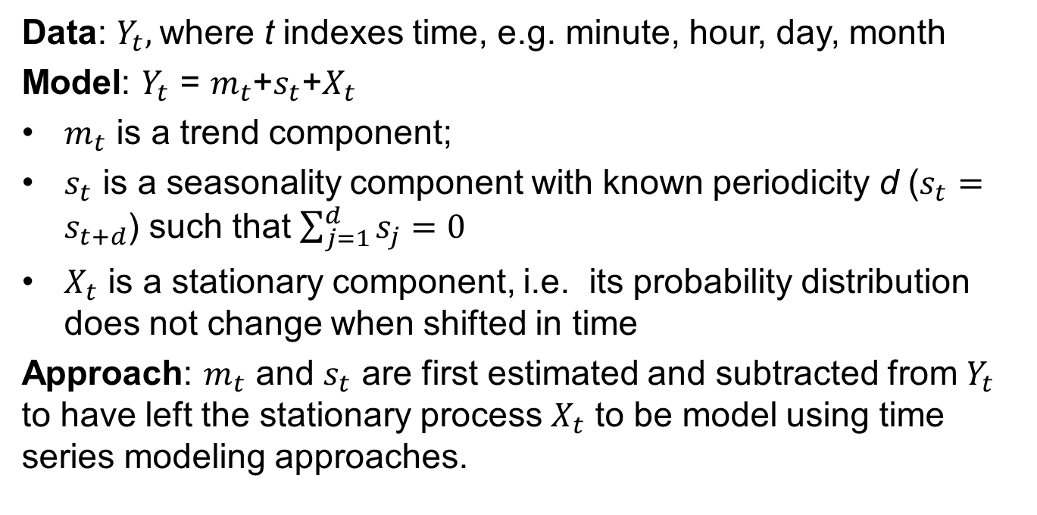
Time Series: Basics
Data: $Y_{t},$where t indexes time, e.g. minute, hour, day, month
Model: $Y_{t}$ = $m_{t}$+$s_{t}$+$X_{t}$
$m_{t}$ is a trend component;
$s_{t}$ is a seasonality component with known periodicity d ($s_{t}=s_{t+d}$) such that $\sum_{j=1}^{d}{s_{j}}=0$
$X_{t}$ is a stationary component, i.e. its probability distribution does not change when shifted in time
Approach: $m_{t}$ and $s_{t}$ are first estimated and subtracted from $Y_{t}$ to have left the stationary process $X_{t}$ to be model using time series modeling approaches.

Slide 4
Time Series: Seasonality
Elimination of Seasonality when there is no Trend
Estimate seasonality and remove it, or
Difference the data to remove the seasonality directly.
Seasonality Estimation Methods
Seasonal Average
Parametric Regression
Fit a mean for each seasonality group (e.g. month) using linear regression
Use a cosine-sin curve to fit the seasonal component

Slide 5

Seasonality: Averaging
For $k=1, 2, .. . ,d$, compute the average $w_{k}$ of
$$\left\{Y_{k+jd}, with k+jd in the time domain\right\}$$
Then
$${\hat{s}}_{k}=w_{k}−\frac{1}{d}\sum_{j=1}^{d}{w_{j}}$$

Slide 6
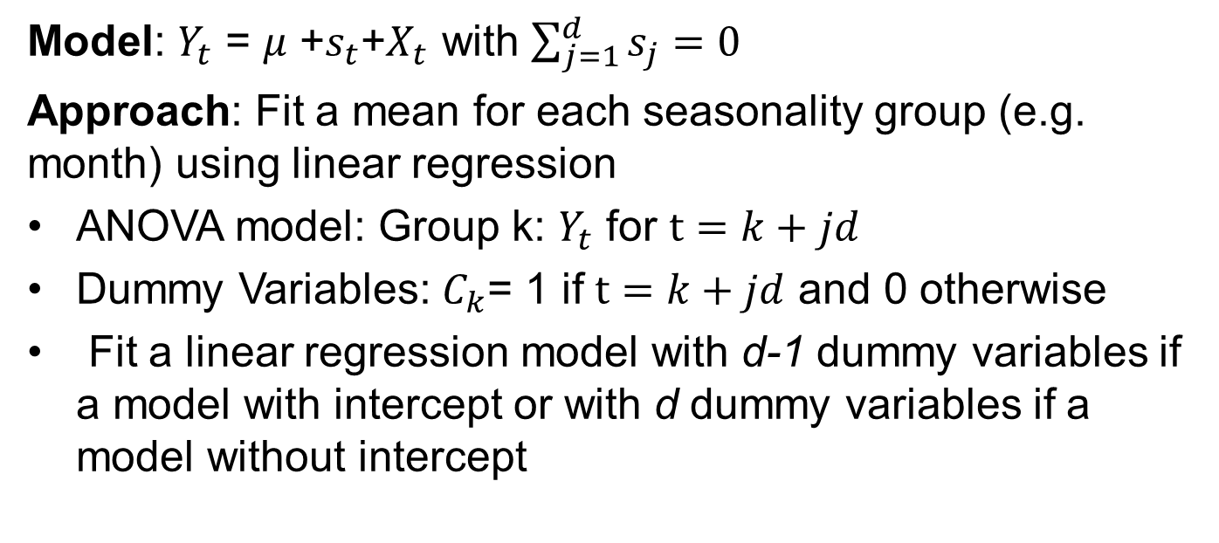
Seasonality: Seasonal Means Model
Model: $Y_{t}$ = $μ$ +$s_{t}$+$X_{t}$ with $\sum_{j=1}^{d}{s_{j}}=0$
Approach: Fit a mean for each seasonality group (e.g. month) using linear regression
ANOVA model: Group k: $Y_{t}$ for $t=k+jd$
Dummy Variables: $C_{k}$= 1 if $t=k+jd$ and 0 otherwise
Fit a linear regression model with d-1 dummy variables if a model with intercept or with d dummy variables if a model without intercept

Slide 7
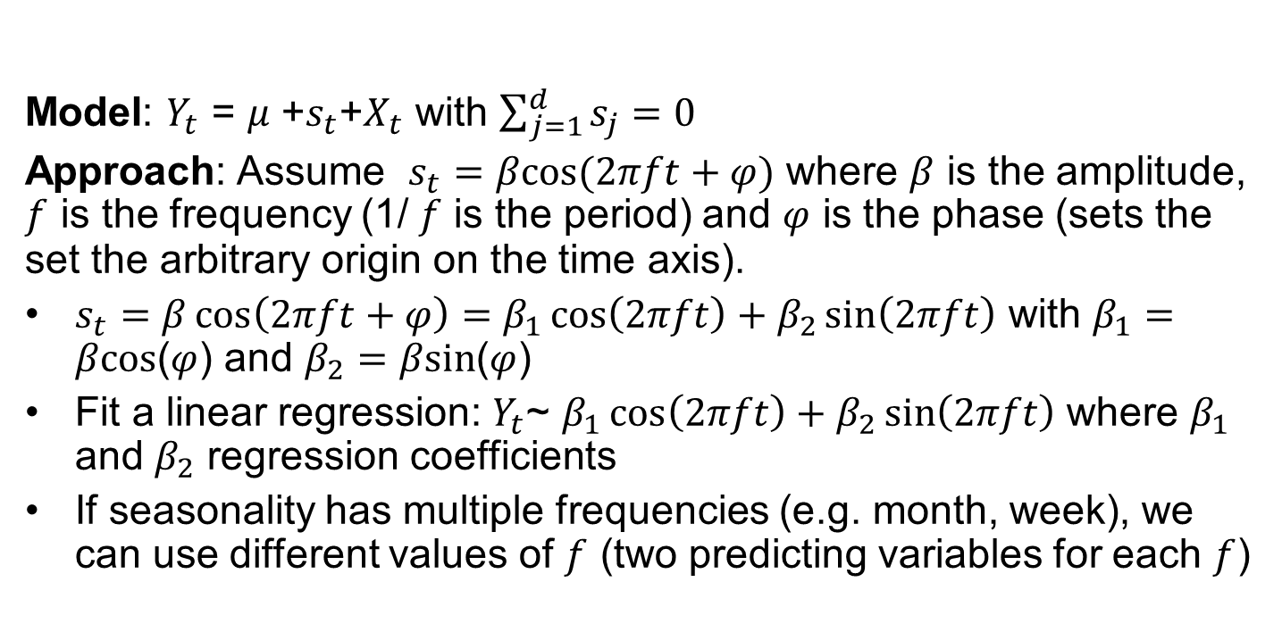
Seasonality: Cosine-Sine Model
Model: $Y_{t}$ = $μ$ +$s_{t}$+$X_{t}$ with $\sum_{j=1}^{d}{s_{j}}=0$
Approach: Assume $s_{t}=βcos⁡(2πft+φ)$ where $β$ is the amplitude, $f$ is the frequency (1/ $f$ is the period) and $φ$ is the phase (sets the set the arbitrary origin on the time axis).
$s_{t}=β\cos\left(2πft+φ\right)=β_{1}\cos\left(2πft\right)+β_{2}\sin\left(2πft\right)$ with $β_{1}=$ $βcos$($φ$) and $β_{2}=$ $βsin$($φ$)
Fit a linear regression: $Y_{t}$~ $β_{1}\cos\left(2πft\right)+β_{2}\sin\left(2πft\right)$ where $β_{1}$ and $β_{2}$ regression coefficients
If seasonality has multiple frequencies (e.g. month, week), we can use different values of $f$ (two predicting variables for each $f$)

Slide 8
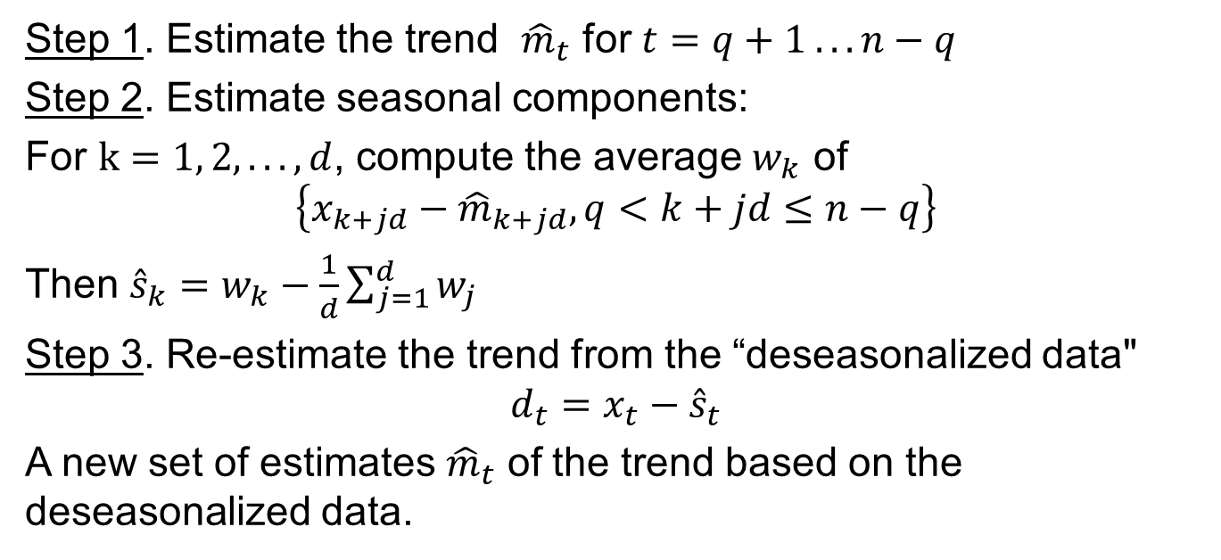
Time Series: Trend & Seasonality
Step 1. Estimate the trend ${\hat{m}}_{t}$ for $t=q+1 .. . n−q$
Step 2. Estimate seasonal components:
For $k=1, 2, .. . ,d$, compute the average $w_{k}$ of
$$\left\{x_{k+jd}−{\hat{m}}_{k+jd}, q<k+jd≤n−q\right\}$$
Then ${\hat{s}}_{k}=w_{k}−\frac{1}{d}\sum_{j=1}^{d}{w_{j}}$
Step 3. Re-estimate the trend from the “deseasonalized data"
$$d_{t}=x_{t}−{\hat{s}}_{t}$$
A new set of estimates ${\hat{m}}_{t}$ of the trend based on the deseasonalized data.

Slide 9
Time Series: Trend & Seasonality (cont’d)
Seasonality: Set the predicting variables
Dummy variables for the seasonal effects (ANOVA)
Cosine and sine variables
Trend: Set the approach
Parametric Regression: Polynomial predicting variables
Nonparametric Regression
Trend and Seasonality: Joint modeling
Linear regression: Seasonality predicting variables and polynomial predicting variables in t
Semiparametric Regression: Nonparametric model for the trend with linear predicting variables for seasonality

Slide 10
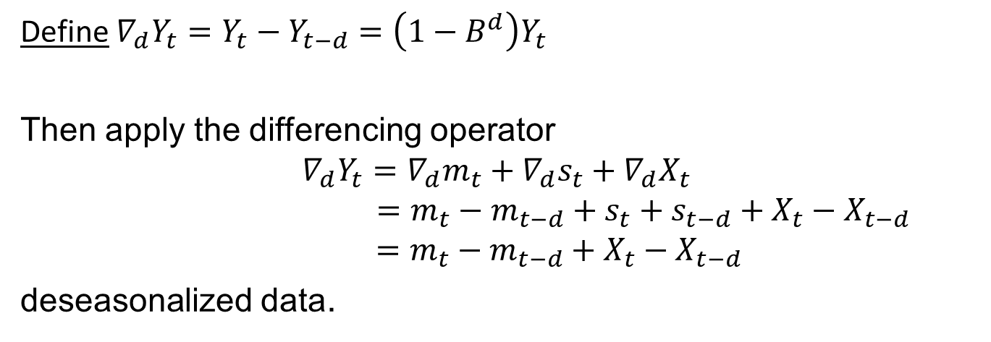
Time Series: Trend & Seasonality (cont’d)
Define $∇_{d}Y_{t}=Y_{t}−Y_{t−d}=\left(1−B^{d}\right)Y_{t}$
Then apply the differencing operator
$$∇_{d}Y_{t}=∇_{d}m_{t}+∇_{d}s_{t}+∇_{d}X_{t}$$
$$=m_{t}−m_{t−d}+s_{t}+s_{t−d}+X_{t}−X_{t−d}$$
$$=m_{t}−m_{t−d}+X_{t}−X_{t−d}$$
deseasonalized data.
This method is recommended when the time series is observed over a long period of time to allow for differencing over long periodicities/seasonality

Slide 11
Summary

